Slide 1
OpenShift Overview

Slide 2
Agenda
What is OpenShift
Features
Basic Concept
How to create application
Build Automation
Application Scaling
Deployment Strategies

Slide 3
What is OpenShift
OpenShift is a cloud development Platform as a Service (PaaS) hosted by Red Hat. It’s an open-source cloud-based user-friendly platform used to create, test, and run applications, and finally deploy them on cloud.
OpenShift is capable of managing applications written in different languages, such as Node.js, Ruby, Python, Perl, Java etc.

Slide 4
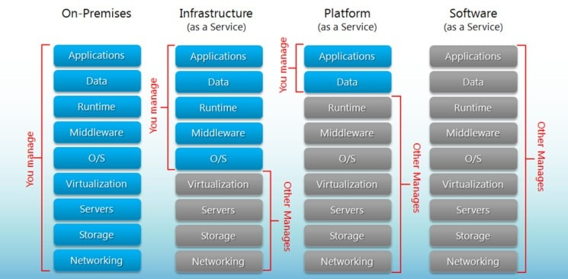
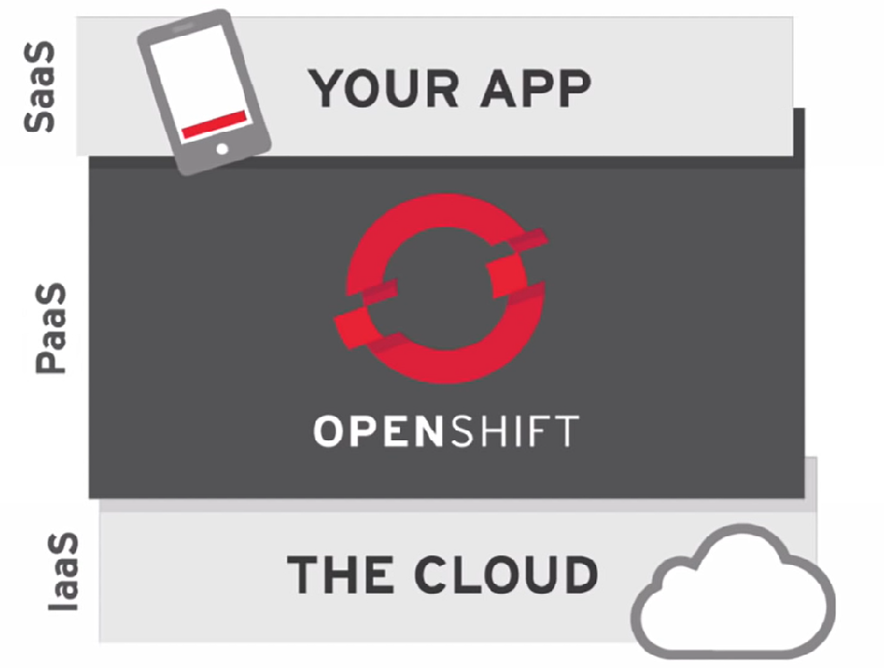
IaaS vs PaaS vs SaaS

Slide 5
Features
Multiple Language Support
Multiple Database Support
Source Code Version Management
Build Management
Automatic Application Scaling
Rich Command-line Toolset
Remote SSH Login to Applications
Continuous Integration and Release Management
Remote Debugging of Applications

Slide 6
Basic Concept
Images : Image is read-only template that contains a set of instructions for creating a container
Containers : Container is a runnable instance of an image. They are created after image is deployed.
Pods : Collection of containers. Each Pod is allocated its own internal IP, so containers within Pods can share their local storage and networking.
Services : Services are logical set of Pods. Service is an abstract layer on top of Pods which provides a single IP & DNS name through which Pods can be accessed. Service serves as an internal load balancer.
Routes : Routing is a method of exposing the service to external world by creating and configuring externally reachable hostname.

Slide 7
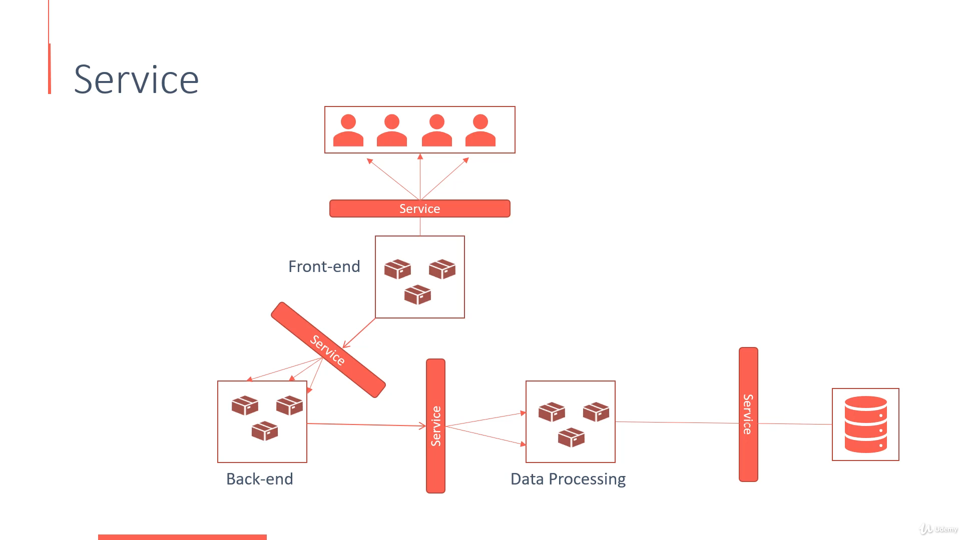
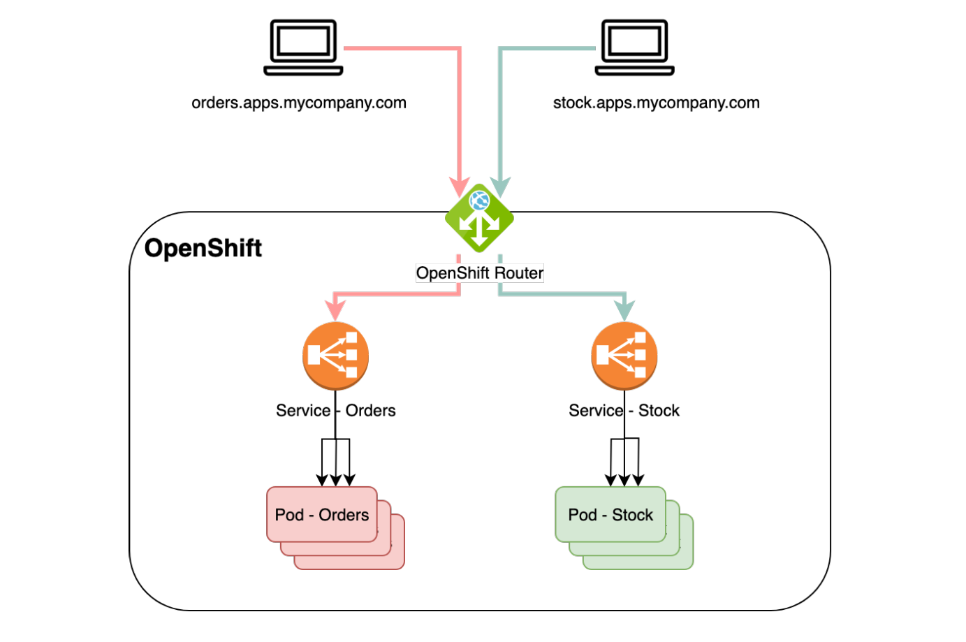

Slide 8
Creating New Application
OpenShift consists of two types of medians to create and deploy applications, either by GUI or by CLI.
In OpenShift, there are 3 methods of creating a new application.
From a source code
From an image
From a template

Slide 9
Build Automation
In OpenShift, we have multiple methods of automating the build pipeline. In order to do that we need to create a BuildConfig resource to describe the build flow. The flow in BuildConfig can be compared with the job definition in Jenkins job definition. While creating the build flow, we have to choose the build strategy.
OpenShift build strategies
Source-to-image strategy
Docker strategy

Slide 10
Application Scaling
Autoscaling is a feature in OpenShift where the applications deployed can scale and sink as and when required as per certain specifications
There are two types of application scaling :
Vertical Scaling
Horizontal Scaling

Slide 11
Deployment Strategies
Deployment strategy in OpenShift defines a flow of deployment with different available methods
following are the important types of deployment strategies
Rolling strategy
Recreate strategy

Slide 12
THANK YOU

